Slide 1
Predicting the success of certain type of food establishment in Russia
Applied Data Science Capstone
By Susanin Dmitry

Slide 2
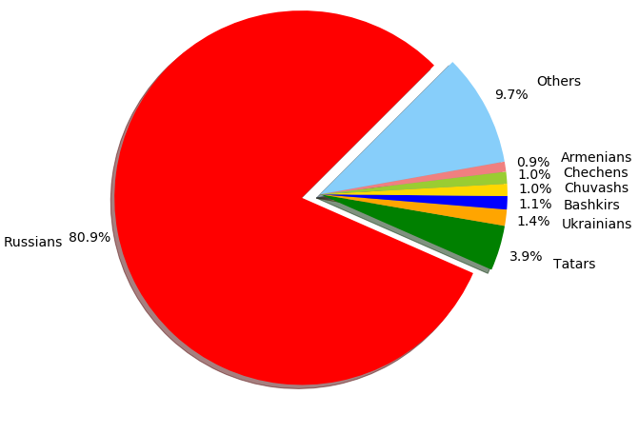
Recommendation model relevance
Russia is a multinational country with more than 190 nations;
there is a great number of cuisines that are preferred in certain regions;
too many factors to predict a hundred percent success;
model allows to give an impression of what type of food establishments should be considered for opening.
Figure 1. Ratio of main nationalities in Russia.

Slide 3
Data acquisition and cleaning
Most data was taken from wiki page https://en.wikipedia.org/wiki/List_of_cities_and_towns_in_Russia_by_population;
location – from geolocator;
additional dataset (sometimes geolocator can’t find any information about some cities), https://simplemaps.com/data/ru-cities;
dropped Federal subject names, Federal district names, Population in 2010 and change in it between 2010 and 2017;
using only 300 first cities by population (the interest of investors is directly proportional to the population of the city).

Slide 4
Methodology
Main idea – to find out which type of food establishment is the most popular in every city of Russia;
using: geopy, Foursquare API, pandas, numpy, folium, matplotlib;
no ML, only a using of data.

Slide 5
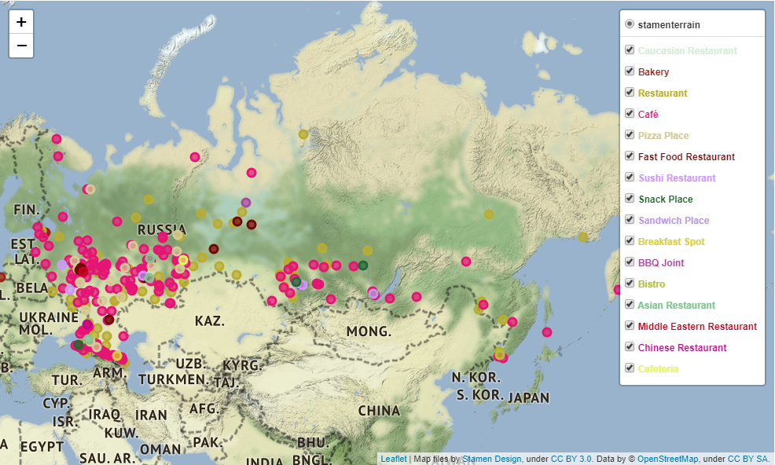
Most popular type – café
Most popular type – café;
there is a lot of fast food, bistro, breakfast spots;
not so many restaurants (mostly in big cities, like Moscow and Saint-Petersburg).
Figure 2. The result map with colored types of food establishments.

Slide 6
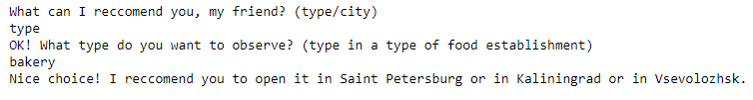
Recommendation helper
In the end of the project there is a little piece of code which recommend what type of food establishment you should open in certain city or in what city you should open certain type.
Figure 3. Result of helper work.

Slide 7
Conclusion and future directions
This project allows us to give an impression of what type of food establishments should be considered for opening;
should not be determined one hundred percent and serves only as a demonstration and a hint for which type is worth a closer look;
there are dozens of other factors that deserve additional research in other projects.

Slide 8
Thank you for your attention!

